Slide 1

BOOST CONVERTER USING MOSFET
Electronic Devices and Circuit
Presenter:
Ahtisham Saleem
(NIM-BSEE-2021-19)
Instructor: Mam Zulikha Kiran
Namal University, Mianwali
1

Slide 2
Table of Content
Introduction
Circuit Diagram
Working of boost converter
Simulation Results
Calculations
References
2

Slide 3
Introduction
The Boost Converter is the Electronic device that uses a MOSFET (IRFZ44N MOSFET in my case) to convert its Low input DC Power into High output DC power.
The Boost Converter is a switched-mode power supply and this consist of at least two semi-conductor device and minimum one energy storage element.
In many domestic and industrial applications, there is a requirement for conversion of DC voltage source to different levels. Thus there is a need for a dc-to-dc converter that converts a fixed-voltage dc source into a variable-voltage dc source.
3

Slide 4
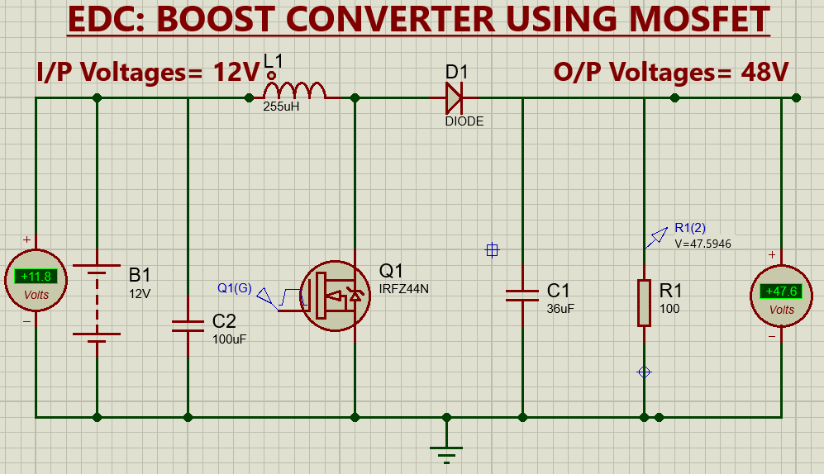
Circuit Diagram
4

Slide 5
Working of boost circuit
Boosting Mechanism: The boost converter increases the input voltage by utilizing the inductor's energy storage and release. When the switch is ON, the inductor stores energy. When the switch is OFF, this stored energy is released, boosting the output voltage.
Operation:
Switch ON: Inductor stores energy, charging the capacitor.
Switch OFF: Inductor releases energy, boosting output voltage and recharging the capacitor.
5

Slide 6
Working of boost circuit
1. Duty Cycle:
Formula: Vout = Vin / (1 - D)
Calculation: 1 - D = 12V / 48V
Result: D = 0.75 (75%)
2. Inductor Value (L1):
Formula: L1 >= (Vin * D) / (2 * fsw * ΔIL)
Calculation: L1 >= (12V * 0.75) / (2 * 50kHz * 0.2A)
Result: L1 >= 225 μH
3. Capacitor Value (C1):
Formula: C1 >= (Iout * D) / (2 * fsw * ΔVout)
Calculation:
Iout = Vout / Rload = 48V / 100Ω = 0.48A
C1 >= (0.48A * 0.75) / (2 * 50kHz * 0.1V)
Result: C1 >= 36 μF
6

Slide 7
References
[1] https://electronicsmind.com/boost-converter/#google_vignette
[2]https://www.theengineeringprojects.com/2021/03/boost-converter-using-mosfet-irfz44n-in-proteus.html
[3] https://www.youtube.com/watch?v=Xqhvv3IPehE
7
7

Slide 8
Thank You
Any Questions?
8

